Slide 1
Technical Support (420-1N6-AB) Hardware – Servers
Fall 2022

Slide 2
Outline
What is a Server?
Server Hardware
Performance and Fault Tolerance

Slide 3
What Is A Server?
A server is a computer or device on a network that manages resources or provides functionality.
To private users inside an organization
Or to public users via the Internet.
Servers can provide various functionalities often referred as “Services”. Such as:
Sharing data.
Sharing/Hosting applications.
Sharing hardware.
Performing computation.

Slide 4

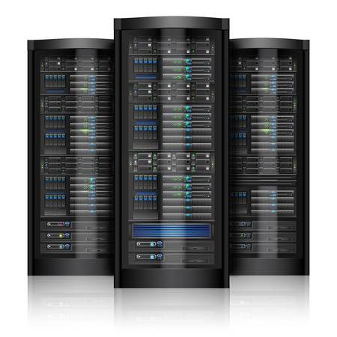
Client/Server Model
Internet / Network
Client sends request
Server send back data
Client
Server

Slide 5
Examples of Servers
File server
Stores and distributes files
Hypervisor server
Hosts virtual machine guest operating systems for remote/shared access
Print server
Allows the management and distribution of printing functionality
Database server
Run database applications that store data and respond to numerous requests from clients
Application/Container server
Runs applications that are shared by a large number of users
Clients do not need to have enough resources nor have to maintain the applications
Mail server
Transfers and stores mail over corporate networks and across the Internet
Web server
Hosts webpages and provides access to them across a network to the user's web browser
Hypervisor/Compute server
Hosts virtual machine guest operating systems for remote/shared access

Slide 6
Server Hardware

Slide 7
Differences Between Servers and Workstations
Servers perform a service (or services) for clients that are connected.
They may provide access to shared files, printers, other network resources, or may provide email and web hosting services.
Workstations are personal computers.
They are used for applications such as word processing, graphical design, development, browsing the web, etc.

Slide 8
Server Hardware Components
In many ways server hardware really isn’t all that different from a workstation PC hardware.
Servers use the same basic components such as:
CPUs.
Main memory.
Secondary storage.
Power supplies.

Slide 9
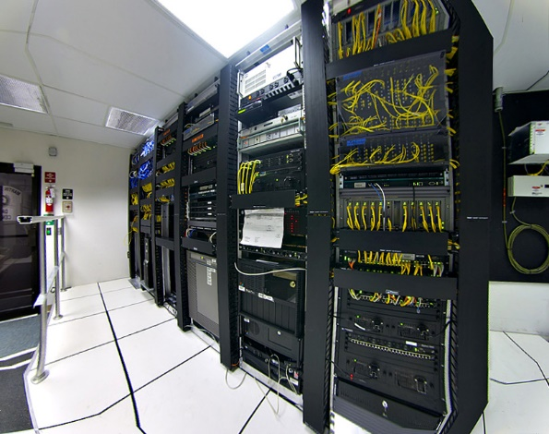
Server Hardware
Servers are
Noisy
Power hungry
Need good Internet access
Require increased security.
Servers are usually stored in dedicated server centers (or data centers).

Slide 10
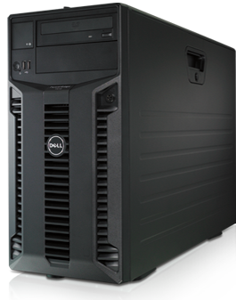
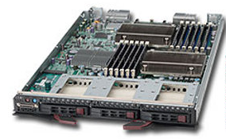
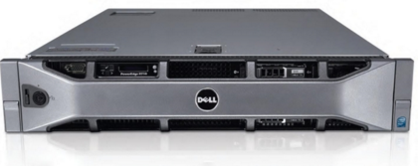
Types of Servers
(Form Factors)
Tower Servers | Rack Servers | Blade Servers

Slide 11
Tower Servers
Look like PCs.
Each tower server is a standalone machine.
Occupy space and tent to be noisy.
Usually used in small data centers.

Slide 12
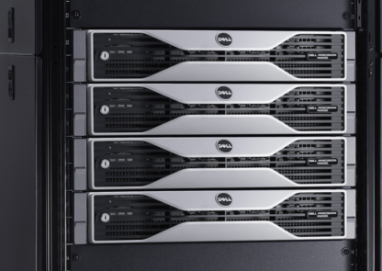
Rack Servers
Servers mounted within a rack.
Uniform width, various heights.
Server heights is measured using rack units.
A standard rack mount server is referred to as a 1U server meaning that it is 1 rack unit in size.
Each rack can accommodate multiple servers which are typically stacked one on top of the other.
Mounted to rack using screws.

Slide 13
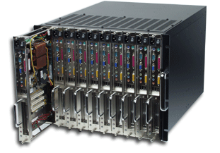
Blade Servers
Mount inside a special rack (chassis).
Blade servers tend to be vendor proprietary.
You can’t for example insert a Dell blade server into an HP chassis.
Lack certain components that rack servers have, e.g. power supplies.
The chassis can include a power supply, cooling unit, etc.

Slide 14
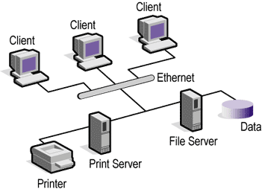
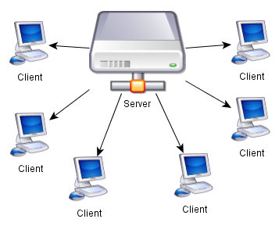
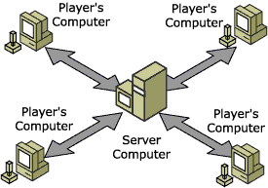
Server Models

Slide 15
Server Hardware vs Computer Hardware
In the hardware sense, the word server means hardware intended for hosting software applications under intense demand.
Most PCs can act as a server, but a dedicated server will contain features making it more suitable for production environments where performance and resilience are important.
Server hardware components are much more expensive.
There is a tradeoff between performance and expense.
For more detail on some important differences/considerations for server hardware:
https://www.techtarget.com/searchdatacenter/Server-hardware-guide-to-architecture-products-and-management
https://www.computerweekly.com/news/2240102027/Sizing-server-hardware-for-virtual-machines

Slide 16
Server Hardware Performance Features
Advanced CPUs
More cores
Extra cache
Hyperthreading
Server hard drives
Resistant to vibrations.
Pools of hard drives stored together for large storage space.
Fast access time.

Slide 17
Fault Tolerance / Redundancy
Fault tolerance, aka Redundancy, is the property that enables a system to continue operating properly in the event of the failure of one (or more) of its components. (Wikipedia)
Fault tolerance is crucial in servers' environments.
Variety of fault tolerance mechanisms:
Redundant files, volumes or drives.
Redundant hardware components or servers.
Hardware components with recovery options.

Slide 18
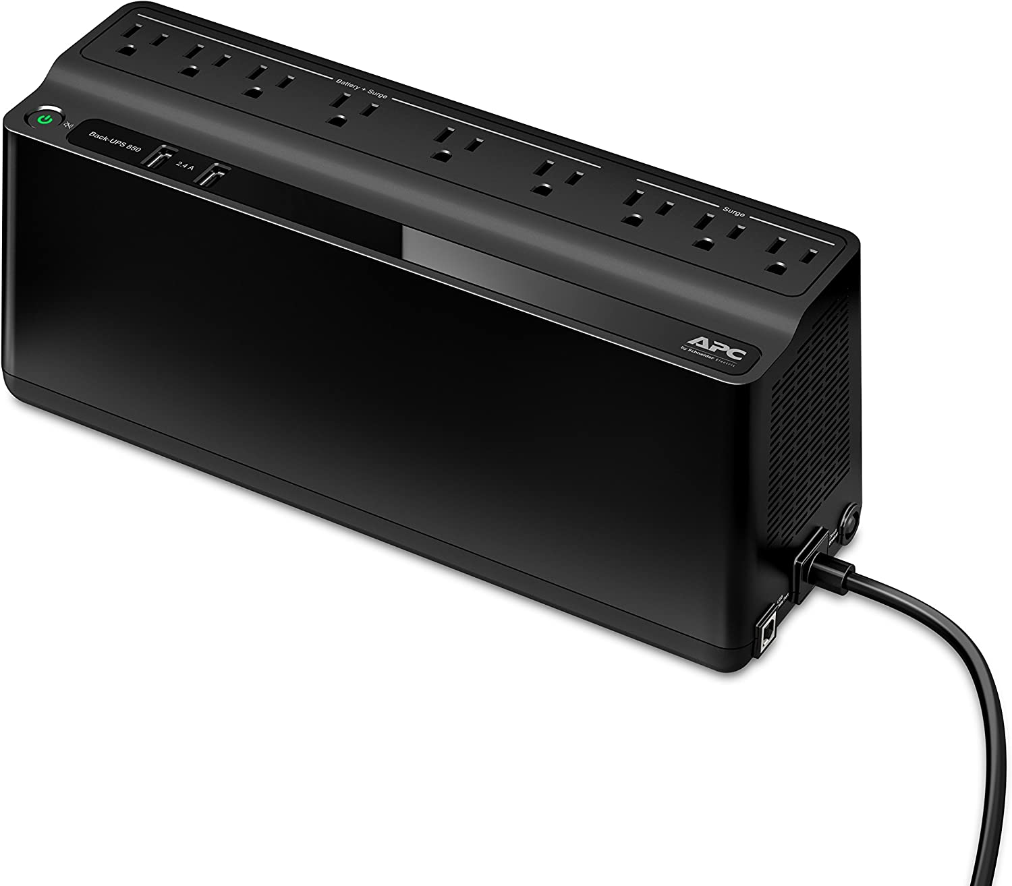
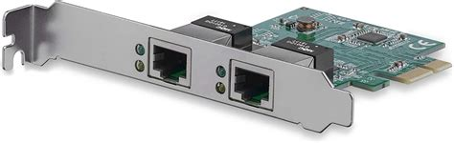
Examples of Fault Tolerance
Power: Redundant power supply (RPS) / Uninterruptible power supply (UPS)
RPS: using more than one power supply to provide redundancy in case one fails
UPS: A kind of power bar that contains a battery (see image to the right). Allows low power operations to continue running and high power operations to shut down gracefully in the event of a power outage/brown-out.
Network: Redundant network interface cards.
Attaching extra NIC (network interface cards) to servers allows duplication/parallization of network connections
Improvement in performance (Combined speed) and provides fault tolerance

Slide 19
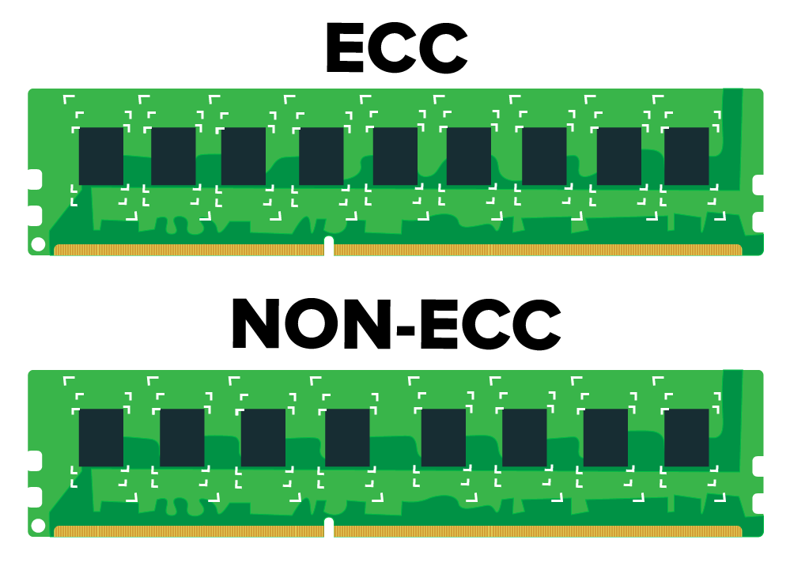
Examples of Fault Tolerance
ECC RAM contains an extra chip to store parity information for error correction
Memory: Memory Modules with error checking (ECC).
RAM with ECC support automatically uses parity (like Assignment 1) to detect and correct the most-common kinds of internal data corruption.
NOTE: not all motherboards are compatible with ECC RAM (consumer-grade motherboards often cheap-out on “non essential” features like this -- it is controversial!)
Storage: RAID (Redundant Array of Independent Disks)
Configure a group of storage disks to stripe, mirror, and/or apply parity to data in storage.
Each of these actions either improves performance or provides fault tolerance
The next set of slides explains all of the possible RAID configurations

Slide 20
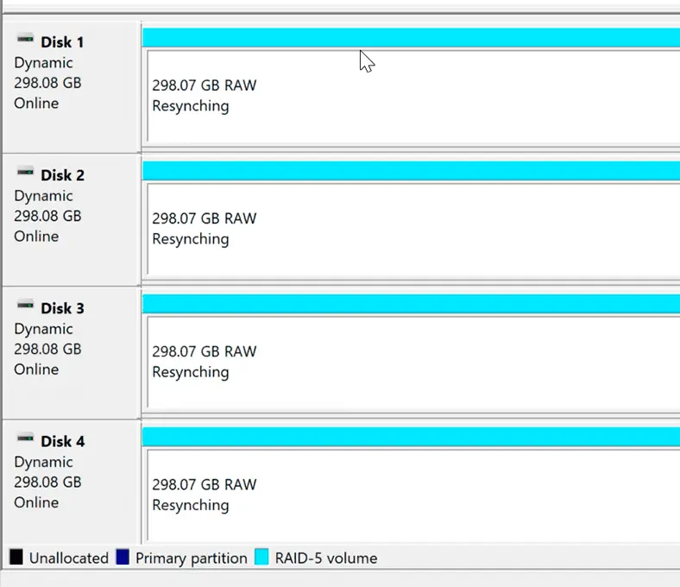
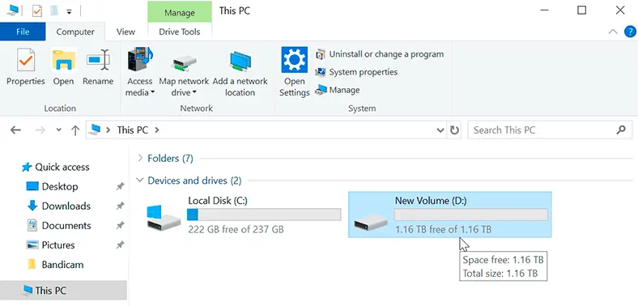
Examples of Fault Tolerance: RAID
Redundant Array of Inexpensive Disks (RAID)
To the operating system, RAID appears as a single logical disk. For example, in the images below, five 300GB disks are combined into a single ~1.2TB volume (the image only shows 4 disks, it’s wrong, sorry -- we’ll learn why in a later slide).
There are 5 common types of RAID: RAID-0, RAID-1, RAID-5, RAID-6, and RAID-10. We will learn the differences in following slides.
images from: https://hetmanrecovery.com/recovery_news/how-to-create-software-raid-on-windows-server.htm

Slide 21
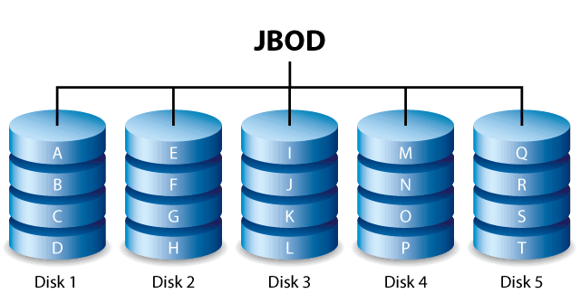
NOT RAID: JBOD “Just a bunch of disks” (No Fault Tolerance)
Before we learn about the clever ways to make a group of disks have fault tolerance, we should start with: what’s the simplest way to combine a storage drives?
That is JBOD, Just a Bunch of Disks. With JBOD, data is spanned across all available disks
Nothing special is done to read or write data: wherever there is space on a disk, data can be written.
No fault tolerance (no parity bits or data mirroring)
Combined storage:
This is the simplest configuration for combining the storage of many disks to appear as one volume.
Each disk can be any size; the total storage is just the total size of the disks (e.g.: 1TB + 2TB + 3TB = 6TB total storage)
note: for disk graphs that look like this, you can consider that each letter is a different file (A is one file, B is another, etc.)

Slide 22
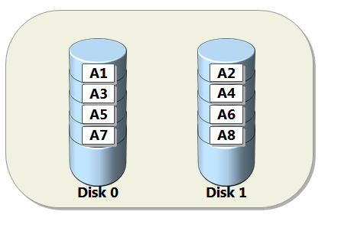
RAID 0: Striping for improved performance
RAID 0 is pretty similar to JBOD, with one key difference:
Data is striped across all available disks. That is, when any new data is written to a disk, it is cut up into blocks which are spread across all disks in the RAID configuration. All files are written to all disks (see right-hand side: A is one file)
Properties:
No fault tolerance (no parity bits or data mirroring)
On HDD: better read/write speed compared to one-huge disk
more access points to data improves read/write speed
SSD read-write speeds are NOT improved from RAID-0. (Why?)
Combined storage:
total capacity = number of disks * size of smallest disk
Why? Data is striped across all disks -- when the smallest disk is full, no more data can be added. In RAID, it is very common to make sure all disks are the same size to prevent wasting space.
https://www.seagate.com/ca/en/internal-hard-drives/raid-calculator/ nice tool for visualizing RAID storage capacity

Slide 23
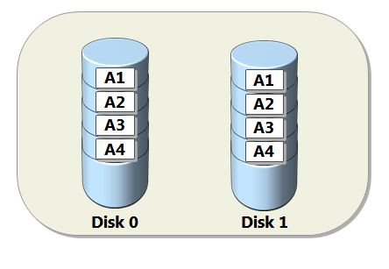
RAID 1: Mirroring for fault tolerance
Disk mirroring where data is copied onto more than one drive simultaneously (NOT striped: copied: note that the file A is divided into four parts, and all four parts are present on both disks)
Simplest and cheapest way to implement fault tolerance.
Minimum of 2 disks required: each additional disk becomes “another mirror”
additional disks provide more protection, but do not provide more storage
Combined storage:
Total capacity = size of smallest disk
RAID 1 is almost exclusively used with just two disks and no more

Slide 24
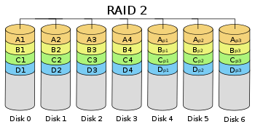
RAID 2-4 (Hardly Used)
We won’t learn RAID 2-4 in detail in this class, but I want to make a quick note:
RAID-2 uses Hamming Code parity, which is the same bit-wise parity scheme we saw in Assignment 1.
You can read more about how the Assignment 1 question worked, and why RAID 2 isn’t used much today, on wikipedia: https://wikiless.org/wiki/Standard_RAID_levels?lang=en#RAID_2

Slide 25
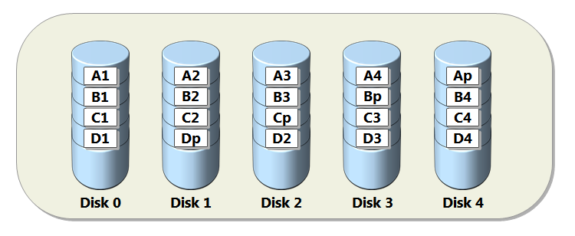
RAID 5: Striping + 1 disk of parity
A common RAID configuration for business servers.
Data and parity (additional data used for recovery) is striped across 3 or more disks, with the equivalent of 1 disk of storage being dedicated to storing parity data.
If any one disk fails, data can be re-created automatically using the parity bits across the remaining disks. Once any more than one disks fails, data is lost permanently.
Great solution for fault-tolerance, but slows down server performance
Combined storage:
Total capacity = (number of disks - 1) * size of smallest disk
Why? One disk is dedicated to parity, the rest are dedicated to storage

Slide 26
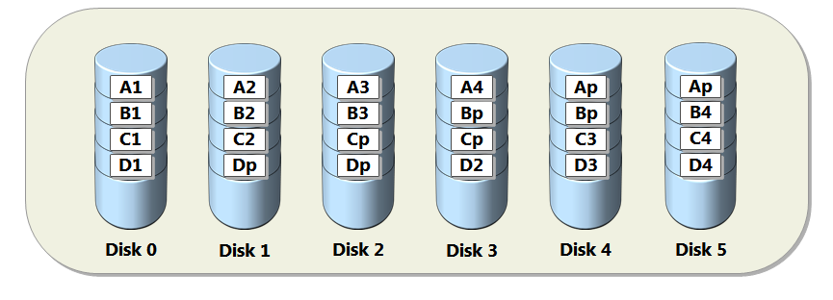
RAID 6: Striping + 2 disks of parity
Identical to RAID 5 but uses one more parity block
more robust: two disks can die
less storage:
Total capacity = (number of disks - 2) * size of smallest disk

Slide 27
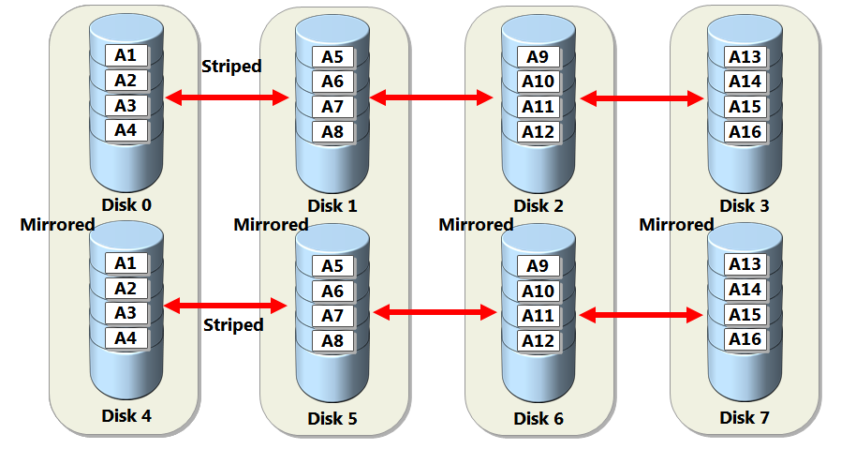
RAID 10 (1+0): Striping + Mirroring
Combination of RAID 0 and 1, combines mirroring of 1 with striping of 0.
Gives best performance but requires twice as many disks (minimum of 4 disks).
Combined storage:
Total capacity = (number of disks * size of smallest disk) / 2
Why? Half of the disks are dedicated to mirroring data

Slide 28
Technical Terms: Parity
The word “parity” comes from the Latin paritas (meaning equal or equivalent). It refers to a way of checking whether data has been lost while it was transmitted. An additional binary digit (parity bit) is added to the group of bits that are moved together. This bit is used for checking whether the bits being transmitted were received correctly.
When a block of data is written, the bits of the data are counted
If the total number of data bits is odd, then the parity bit is set to 1 (so that the total number + party bit is even).
If the total number is even, the parity bit is set to 0 (so that the total number remains even)
When that block of data is later read, each group of bits is checked to see if the group total is an even or odd number.
If the total is ODD then a transmission ERROR has occurred which can be located on the disk (see Assignment 1)
Otherwise, the data has not been corrupted and no corrections need to be made.
NOTE: This is called “even-parity” (it is possible to configure the system backwards, where ODD parity indicates there are no errors -- this is called “odd-parity” ECC, both conventions work just fine)

Slide 29
Technical Terms: Striping
Disk striping is the process of dividing data into blocks and spreading the data blocks across multiple storage devices.
Different storage systems can stripe in different ways (e.g. at byte or block level).
Striping provides high performance (faster reading and writing of data), but low resiliency (failure in any physical drive would result in data loss).

Slide 30
Technical Terms: Mirroring
Mirroring involves writing the same data to more than one disk.
It is a good choice for applications that require high performance and high availability such as transactional applications.
Data can be read from both disks simultaneously, making read operations fast. However, write operations are slower because they have to be carried out twice.

Slide 31
Q & A
Notes:
In Slide Show mode, click the arrow to enter the PowerPoint Getting Started Center.

